Slide 1
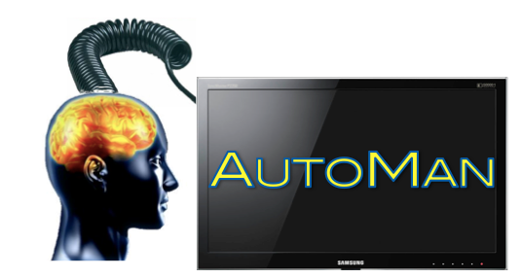
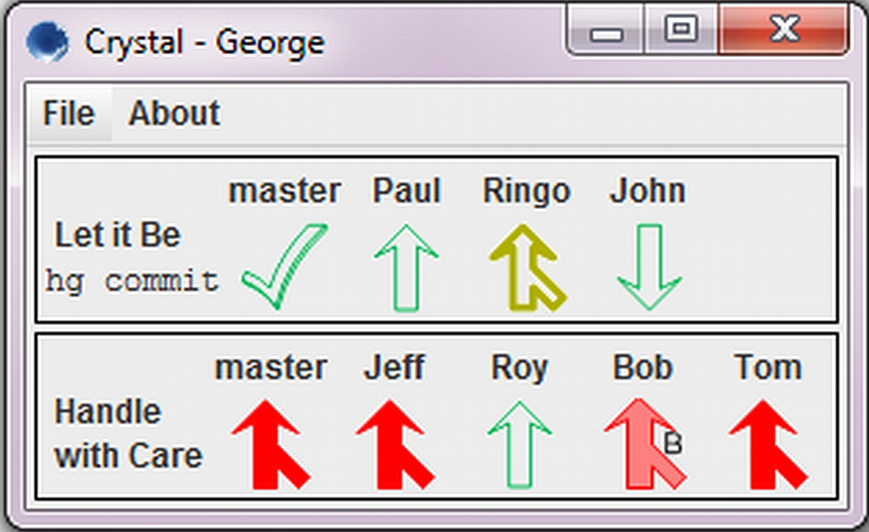
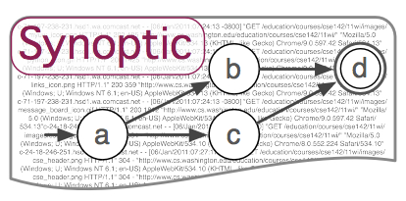
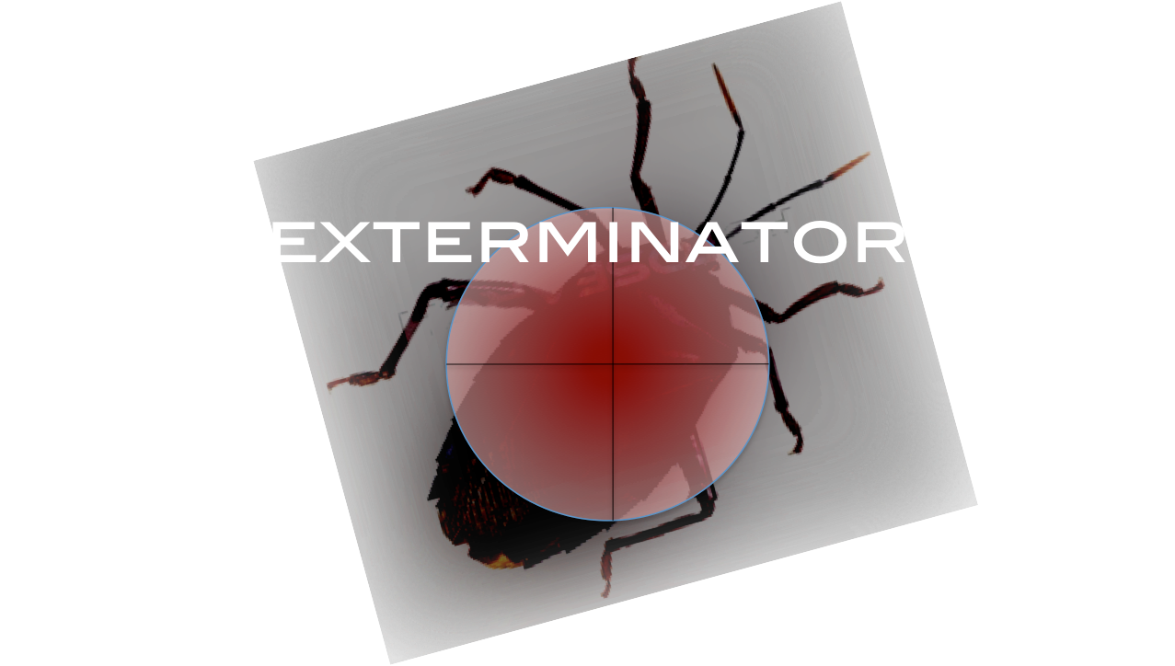
Emery Berger
CS 344
Yuriy Brun
CS 346
Arjun Guha
joining fall 2013
programming with people
predicting collaboration conflicts
software understanding
fixing bugs automatically

